Slide 1
Trees

Slide 2
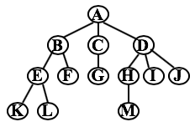
Definition of a tree
A tree is a finite set of nodes with the following properties:
(1) There is a node called the “root”.
(2) All the children of a root are the roots of a subtree .

Slide 3
Tree-related terminology
Degree of a node: number of subtrees of a node. See diagram: degree(A) = 3 , degree(F) = 0.
Leaf: A node with a degree of 0.
Parent: The node that has a subtree.
Child: The root of the subtree of a given parent node.
Siblings: Children who share the same parent node.
Ancestor: All nodes traversed from a given node up to the root.
Descendants : All nodes in subtrees.
Level: Parent level + 1; Level of root = 1.
Height / Depth: max {levels​}.
Level
A
1
B
C
D
2
E
F
G
H
I
J
3
K
L
M
4

Slide 4
Tree representation (list representation)
The size of a tree node will vary depending on the number of its subtrees, which is clearly not a good approach.
Level
A
1
(A)
B
C
D
2
(A (B, C, D))
E
F
G
H
I
J
3
( A ( B ( E, F ), C ( G ), D ( H, I, J ) ) )
K
L
M
4
( A ( B ( E ( K, L ), F ), C ( G ), D ( H ( M ), I, J ) ) )

Slide 5
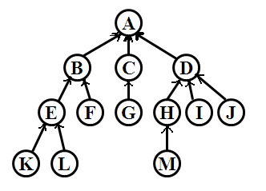
Tree representation (parent representation)
Parent representation
struct Node{
int value;
int parent;
}node[N];
Each node points to its parent, making it easy to find ancestors from the leaves, but not down from the root node.
Notes:
Proof of Property 1

Slide 6
Representation of a tree (childREN and sibling representation)
data
A
left child
right sibling
N
A
B
C
D
N
B
C
D
E
F
G
H
I
J
E
F
G
H
I
J
N
N
N
N
N
N
N
K
L
M
K
L
M
N
N
N
N
N
Notes:
Proof of Property 1

Slide 7
Representation of a tree (child-parent representation)
Parental representation of children
struct Node{ struct Node{
int value; int value;
int child_count; vector<int> child;
int child[M]; int parent;
int parent; }node[N];
}node[N];
Each node stores information about all its children (and points to its parents), allowing for bidirectional lookups.
Use vector to solve the problem of dynamic memory allocation.
Notes:
Proof of Property 1

Slide 8
Tree traversal
Traversal (preorder traversal, postorder traversal)
void preorder(int id){
if (id > 0){
visit(id);
for each child of node[id] (from left to right)
preorder(child);
}
}

Slide 9
Unrooted trees
F
I
B
A
D
E
C
H
J
G
M
K
L
D
A
A
H
I
J
B
C
D
B
C
M
E
F
G
H
I
J
E
F
G
K
L
M
K
L
Notes:
Proof of Property 1

Slide 10
Representation of unrooted trees (edge list)
Edge list representation
struct Edge{
int u,v;
}e[N];
This representation simple; all the edges represent all the information of the unrooted tree.
However, this representation method is inefficient.
Notes:
Proof of Property 1

Slide 11
Representation of unrooted trees (Linked forward star)
Chain forward star
struct Edge{ void add_edge (int u, int v){
int v, next; ++tot;
}e[N*2]; e[tot].v = v;
int head[N], tot=0; e[tot].next = head[u];
head[u] = tot;
}
Complex in structure, but highly efficient.
Notes:
Proof of Property 1

Slide 12
Converting unRooted trees to rooted trees
Using edge table representation
void set_parent(int id, int fid){
fa[id] = fid;
for (int i = 1; i < n; ++ i){
int u=e[i].u, v=e[i].v;
if (u == id && v != fid) set_parent(v, id);
else if (v == id && u != fid) set_parent(u, id);
}
}
int root, fa[N];
root = ...;
set_parent(root, 0);
Notes:
Proof of Property 1

Slide 13
Converting unRooted trees to rooted trees
Using linked forward start representation
void set_parent(int id, int fid){
fa[id] = fid;
for (int i = head[id]; i; i = e[i].next)
if (i.v != fid)
set_parent(i.v, id);
}
int root, fa[N];
root = ...;
set_parent(root, 0);
Notes:
Proof of Property 1

Slide 14

Binary trees
A binary tree is tree whose degree does not exceed 2.
Characteristics of binary trees: The maximum number of nodes in the $i$-th layer is $2^{i−1}$. The maximum number of nodes in a binary tree with height $k$ is $2^{k}−1$.
Skewed binary tree
Complete binary tree
A
A
A
B
B
B
C
C
C
D
E
F
G
D
D
H
I
Left skewed
Right skewed

Slide 15
Representation of a binary tree (child-parent representation)
Commonly used storage structures
struct Node{
int value;
int parent, lchild, rchild;
}node[N];

Slide 16
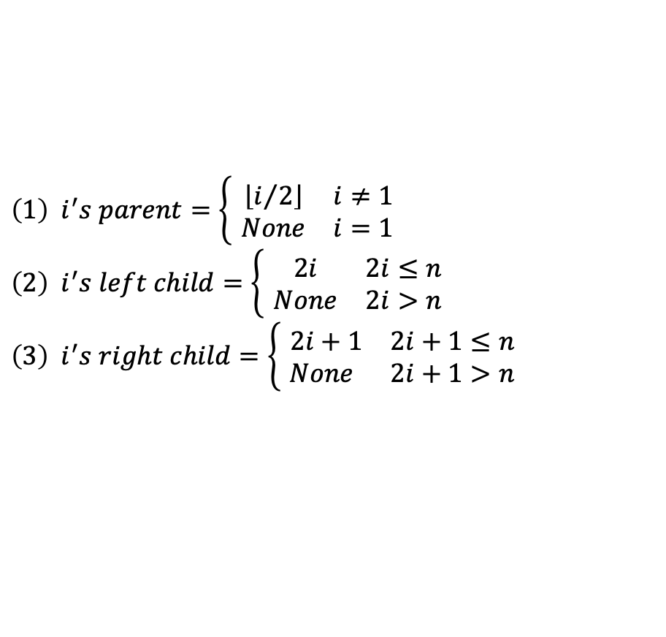

Representation of a binary tree (array representation)
For a complete binary tree represented by an array, for any node $i$, we have:
A
B
C
D
E
F
G
$$\left(1\right) i^{′}s parent=\left\{\begin{matrix} \left\lfloor i/2\right\rfloor & i≠1 \\ None & i=1\end{matrix}\right. \\ \left(2\right) i^{′}s left child=\left\{\begin{matrix} 2i & 2i≤n \\ None & 2i>n\end{matrix}\right. \\ \left(3\right) i^{′}s right child=\left\{\begin{matrix} 2i+1 & 2i+1≤n \\ None & 2i+1>n\end{matrix}\right.$$
H
I
1 | 2 | 3 | 4 | 5 | 6 | 7 | 8 | 9
A | B | C | D | E | F | G | H | I

Slide 17
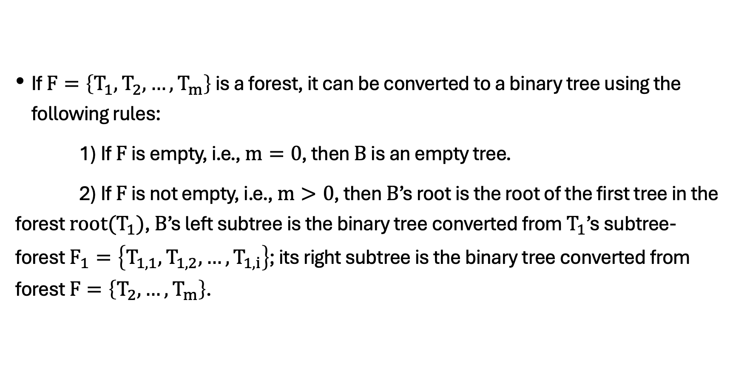
Converting A Forest To a binary tree
If $F=\left\{T_{1},T_{2},…,T_{m}\right\}$ is a forest, it can be converted to a binary tree using the following rules:
1) If $F$ is empty, i.e., $m=0$, then $B$ is an empty tree.
2) If $F$ is not empty, i.e., $m>0$, then $B$’s root is the root of the first tree in the forest $root(T_{1})$, $B$’s left subtree is the binary tree converted from $T_{1}$’s subtree-forest $F_{1}=\left\{T_{1,1},T_{1,2},…,T_{1,i}\right\}$; its right subtree is the binary tree converted from forest $F=\left\{T_{2},…,T_{m}\right\}$.

Slide 18
Converting A Forest To a binary tree
A
A
B
C
D
B
I
E
F
G
H
E
C
J
F
D
K
I
G
L
J
K
L
M
N
H
M
O
N
O

Slide 19
Binary tree traversal
Traversal (preorder traversal, inorder traversal, postorder traversal)
void preorder(int fa){
if (fa > 0){
visit(fa);
preorder(lchild[fa]);
preorder(rchild[fa]);
}
}

Slide 20
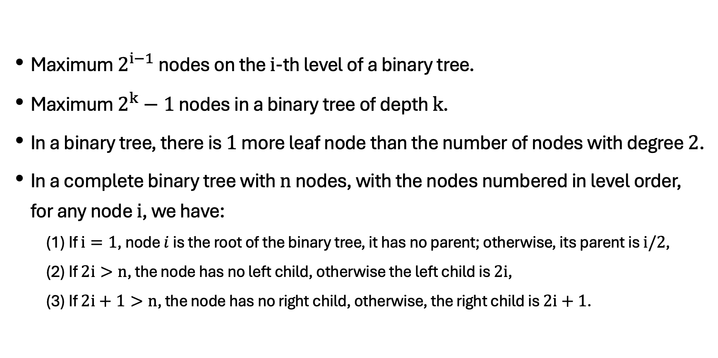
characteristics of binary trees
Maximum $2^{i−1}$ nodes on the $i$-th level of a binary tree.
Maximum $2^{k}−1$ nodes in a binary tree of depth $k$.
In a binary tree, there is $1$ more leaf node than the number of nodes with degree $2$.
In a complete binary tree with $n$ nodes, with the nodes numbered in level order, for any node $i$, we have:
(1) If $i=1$, node $i$ is the root of the binary tree, it has no parent; otherwise, its parent is $i/2$,
(2) If $2i>n$, the node has no left child, otherwise the left child is $2i$,
(3) If $2i+1>n$, the node has no right child, otherwise, the right child is $2i+1$.
Notes:
Jack Edmonds and Richard Karp

Slide 21
Binary Sort Tree (BST)
A binary sort tree is also known as a binary search tree.
It is either an empty tree or a binary tree with the following properties:
(1) If its left subtree is not empty, then the value of all nodes in the left subtree is less than the value of the root node.
(2) If its right subtree is not empty, then the value of all nodes in the right subtree is greater than the value of the root node.
(3) Its left and right subtrees are also binary sort trees.
Notes:
Jack Edmonds and Richard Karp

Slide 22
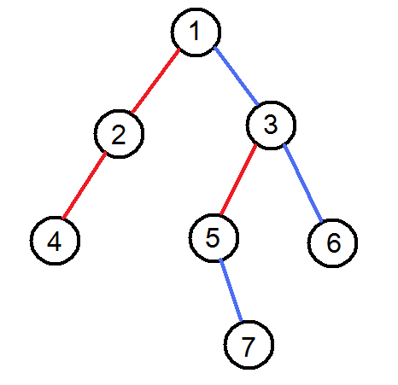
Binary sort Tree
There are two types of edges in a binary search tree:
Red edge: indicates the parent’s left son.
Blue edge: indicates the parent’s right son.
Notes:
Jack Edmonds and Richard Karp

Slide 23
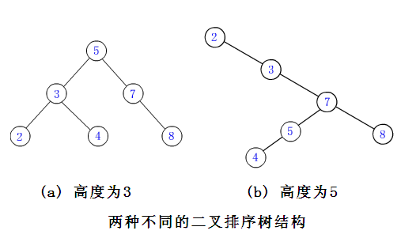
Example
(a) height is 3
(b) height is 5
2 different BST structures
Notes:
Jack Edmonds and Richard Karp

Slide 24
Searching a BST
int bst_search(int rt, int key){
if (rt == 0 || data[rt]==key) return rt;
if (data[rt] < key)
return bst_search(lch[rt], key);
else
return bst_search(rch[rt], key);
}

Slide 25
Inserting into a BST
To insert a new node into a BST while maintaining the BST properties, the insertion process is as follows:
(a) If the BST T is empty, allocate a new node for the key to be inserted and make it the root; (b) If the BST T is not empty, compare key with the key of the root: (i) If they are equal, key already exists in the tree and no insertion is needed. (ii) If key < T→key, insert key into the left subtree of the root. (iii) If key > T→key, insert key into the right subtree of the root.
The insertion process in the subtree is the same as described above. This continues until key is inserted into the BST as the key of a new leaf node, or until key is found in one subtree.
Notes:
Jack Edmonds and Richard Karp

Slide 26
Inserting into a BST
void bst_ins(int &rt, int key){
if (!rt) {rt = new_node(key); return;}
if (data[rt] == key) return;
if (data[rt] < key)
bst_ins(lch[rt], key);
else
bst_ins(rch[rt], key);
}

Slide 27
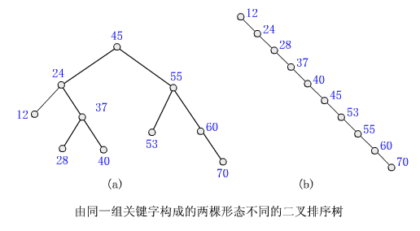
Generating a BST
BST generation is a process of continuous insertion.
However, when generating a BST, a poorly chosen root node can lead to a skewed tree, reducing search efficiency. Randomly selecting the root node can help balance the BST . The image below shows two BSTs with the same key .
2 differently shaped BST comprising of the same set of keys

Slide 28
Deleting from a BST
We will discuss three scenarios:
1) Deleting a leaf node does not destroy the tree structure; its parent node can be modified instead.
2) If there is only a left child or only a right child, then you can simply replace that child node.
3) Find the node with the maximum value in the left subtree and replace it.
int q = p, s = lch[p];
while (rch[s]) {q = s; s = rch[s];}
data[p] = data[s];
if (p == q) lch[q] = lch[s]; else rch[q] = lch[s]; // s recyclable

Slide 29
BST time complexity
BSTs can be used to represent ordered sets, create indexes, or priority queues.
In the worst case, the time complexity of basic operations performed on a BST can reach O(n).
Some variations of BSTs, such as red-black trees and AVL trees, still perform well in the worst case for basic operations.

Slide 30
Thank you everyone.

